Slide 1
Deep learning for robotic grasp detection
Ollie Thomas (olt13)

Slide 2
Project Aims
Robotic grasping
Tend to have grasps databases
Unable to grasp new objects
Deep learning
Apply convolutional neural networks to the topic
Like demonstrated by other researchers

Slide 3
Project overview
Three main parts:
Developing the simulation environment
Generating the dataset and training the DCNN
Integrating the model into the simulation

Slide 4


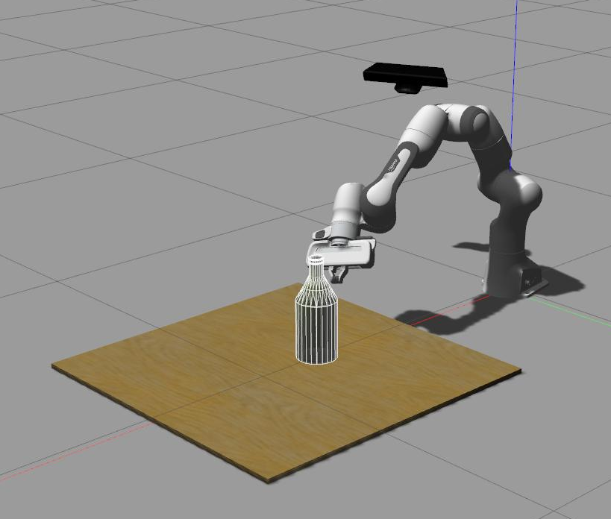
Simulation Environment
Robot Operating System (ROS)
Gazebo / Rviz
Franka Emika Panda arm
Kinect depth camera

Slide 5
Demonstration

Slide 6
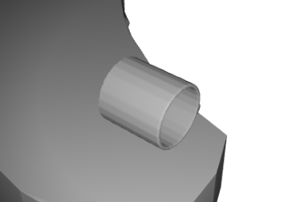
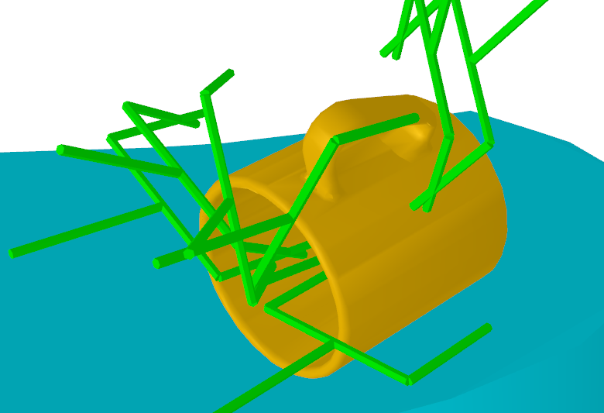
Grasp dataset
Using ACRONYM dataset
Grasp transforms from target object
Link to ShapeNetSem models
Tools for visualizing the grasps and rendering depth images of objects
Using images generated from Gazebo

Slide 7
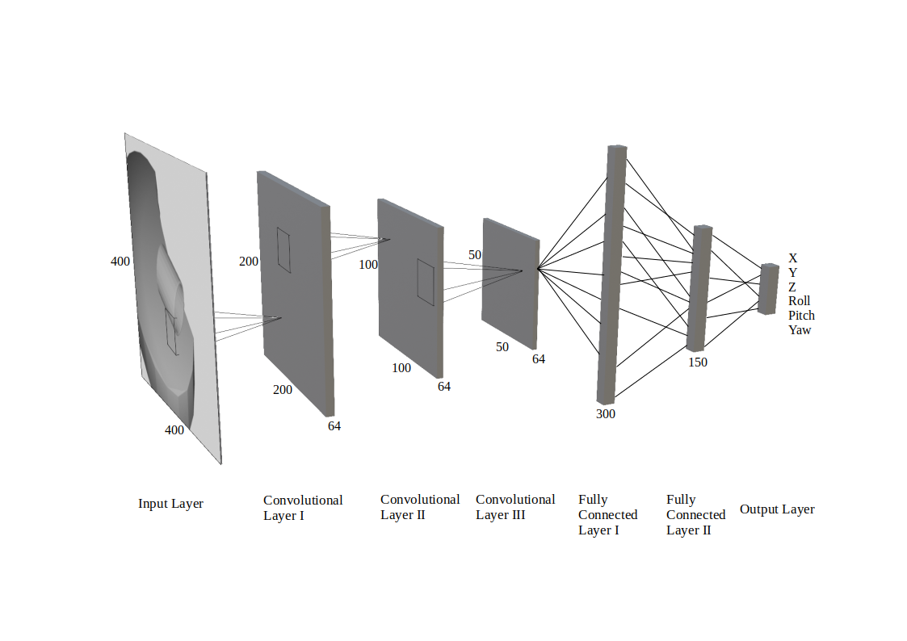
Convolutional neural network
Tensorflow
Sequential API
Conv2d and Dense layers
Integrated into the simulation environment once trained
The diagram shows the current design, but is yet to be optimised for the project.

Slide 8
Evaluation pipeline
Loading random objects into Gazebo
Generating a grasp from the depth image
Reaching to the grasp pose and grasping the object
Checking the gripper closure to determine success

Slide 9
Questions

